Slide 1
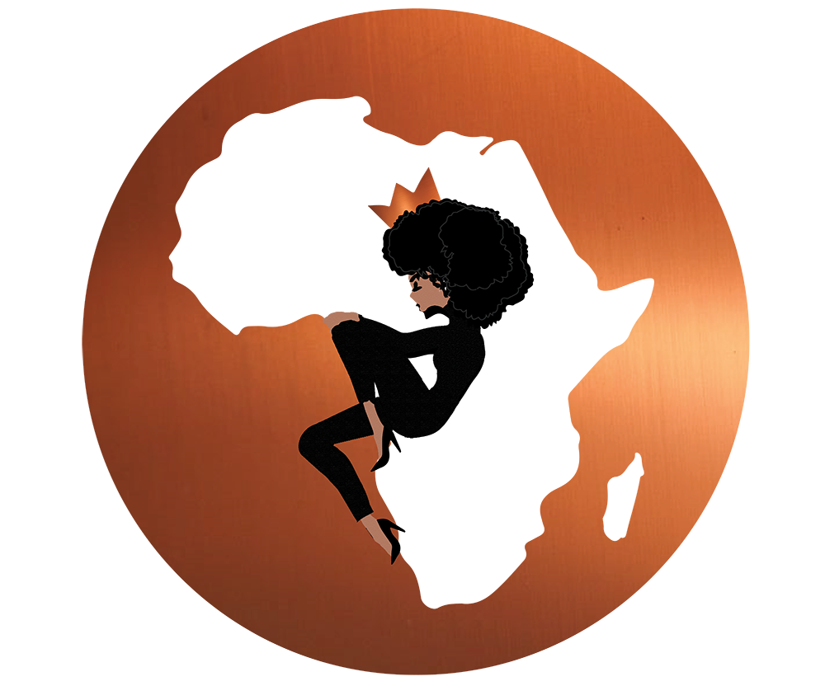
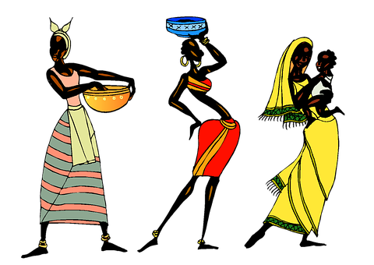
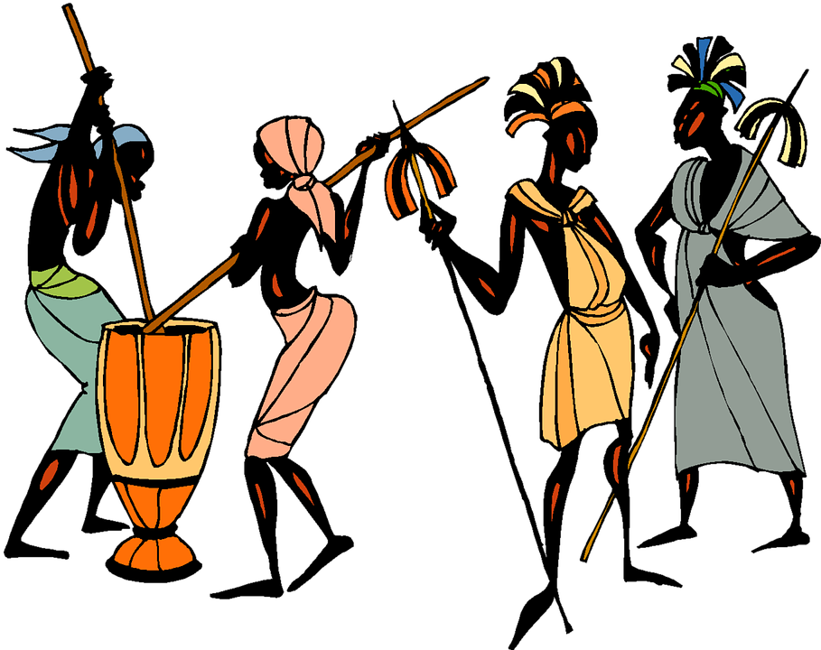
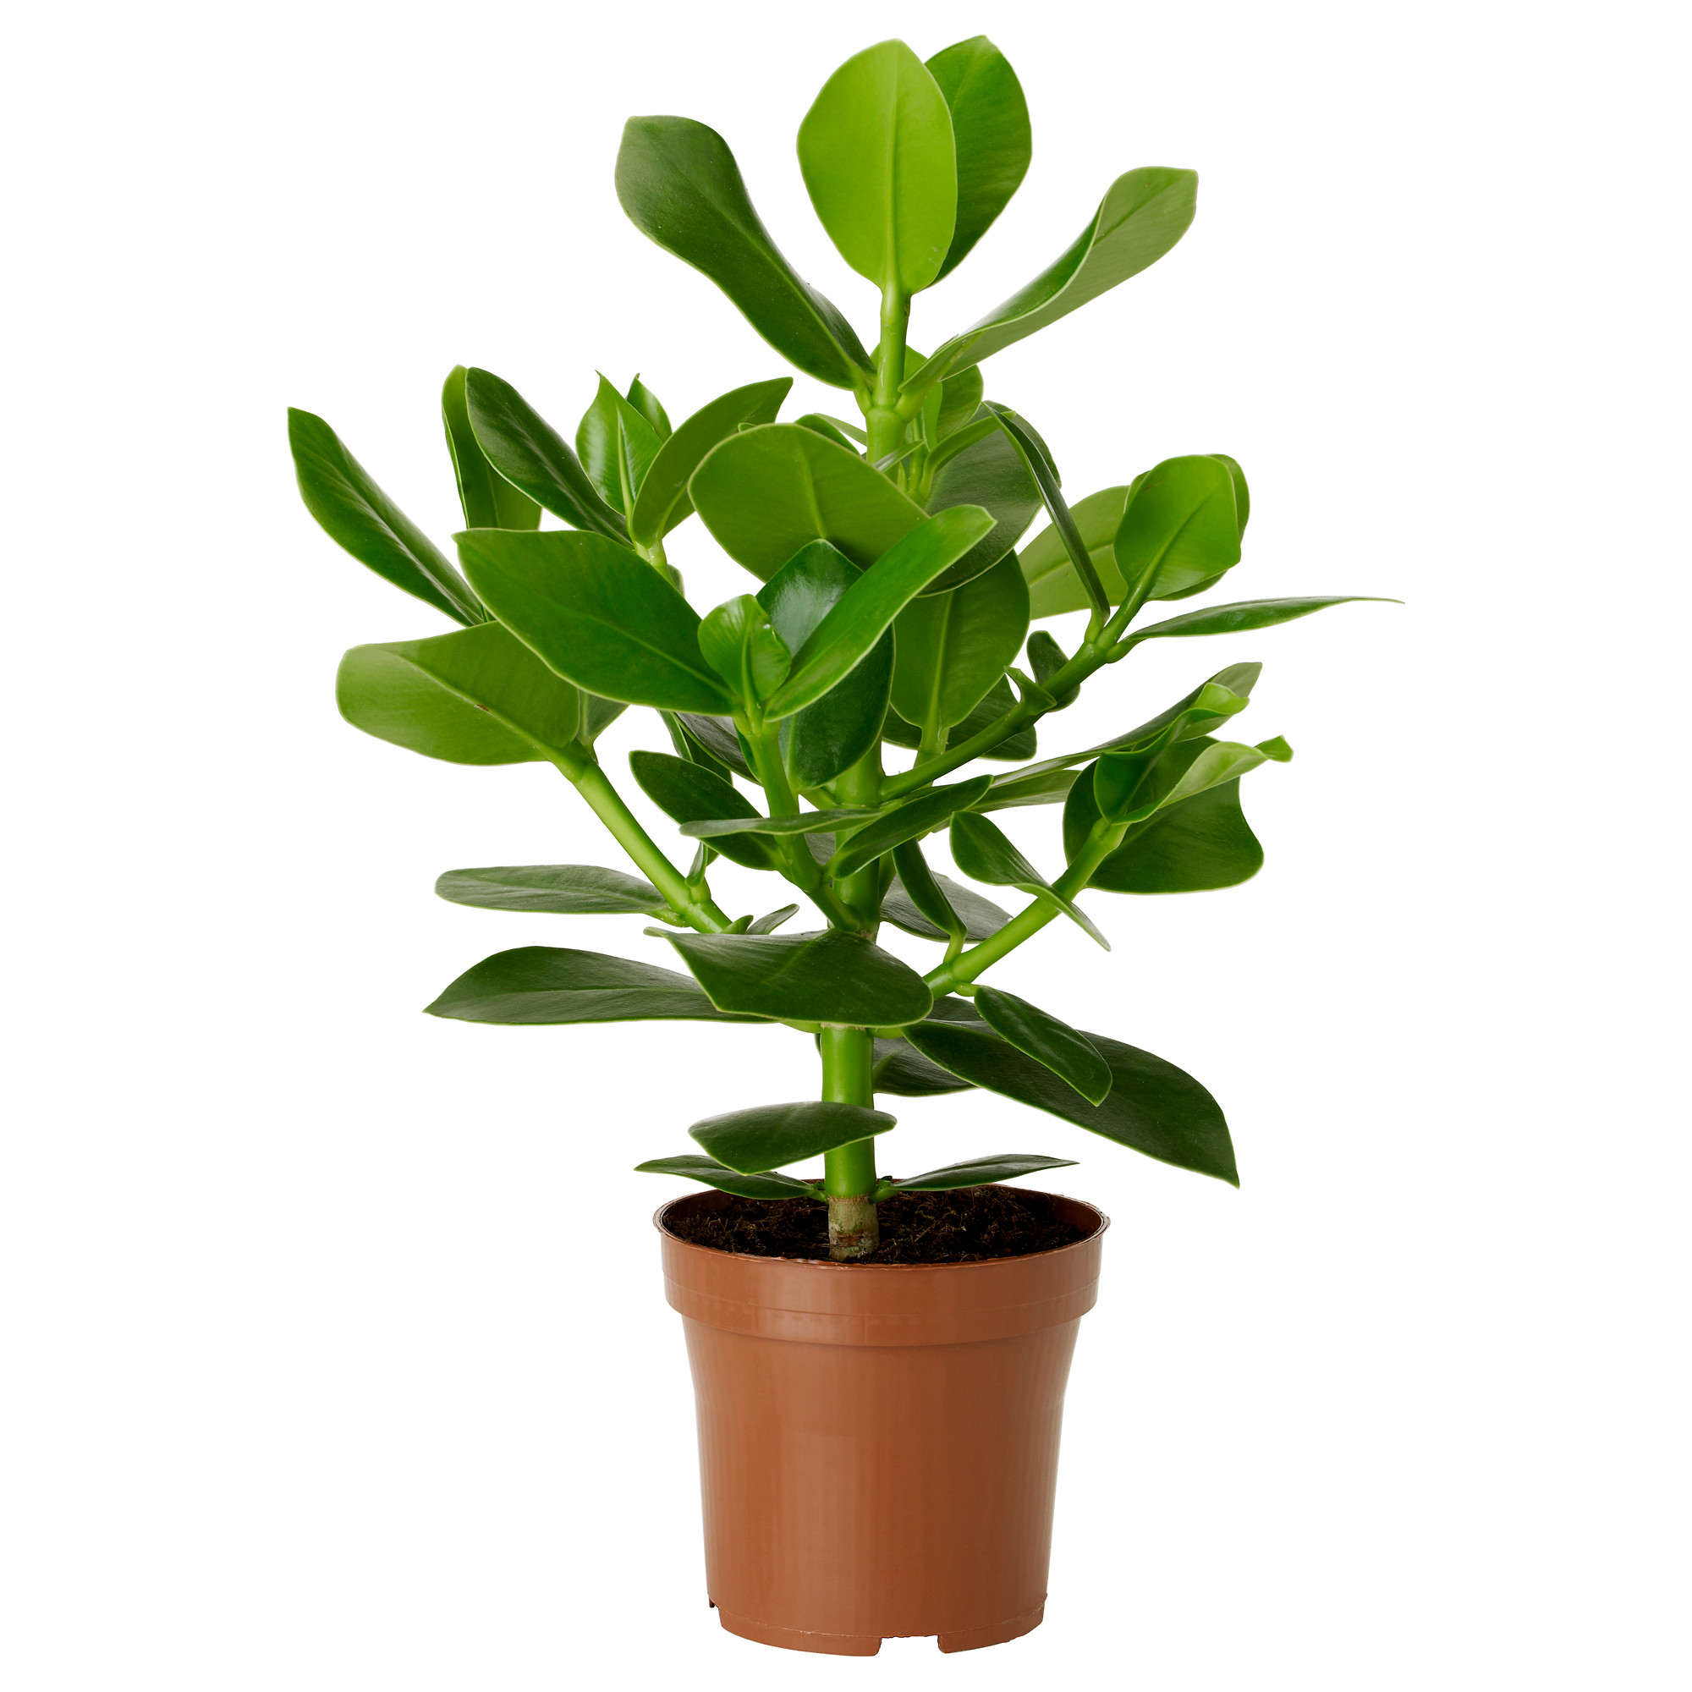
Our culture
Our Nature
Our Geography
Tumukunde Ibrahim
WELCOME TO AFRICA

Slide 2

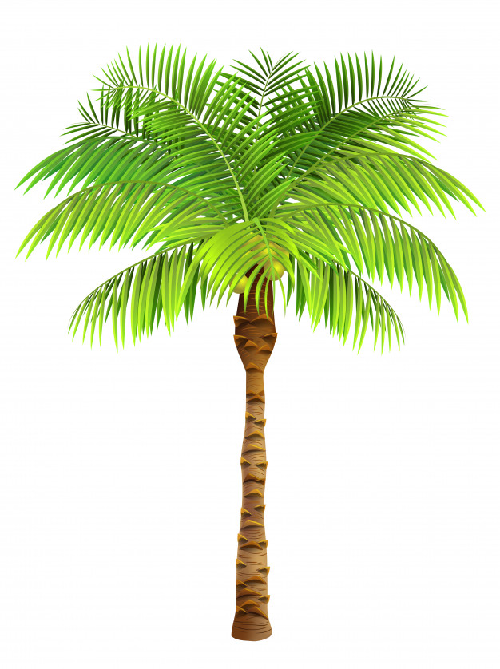
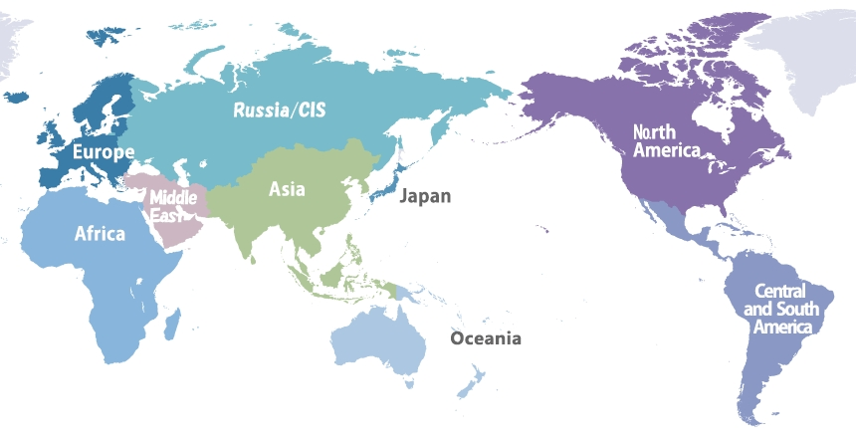
OUR GEOGRAPHY
Africa is a Continent With 54 countries
Japan is located in the eastern of Africa
2nd largest continent after Asia with an area of 30,370,000

Slide 3


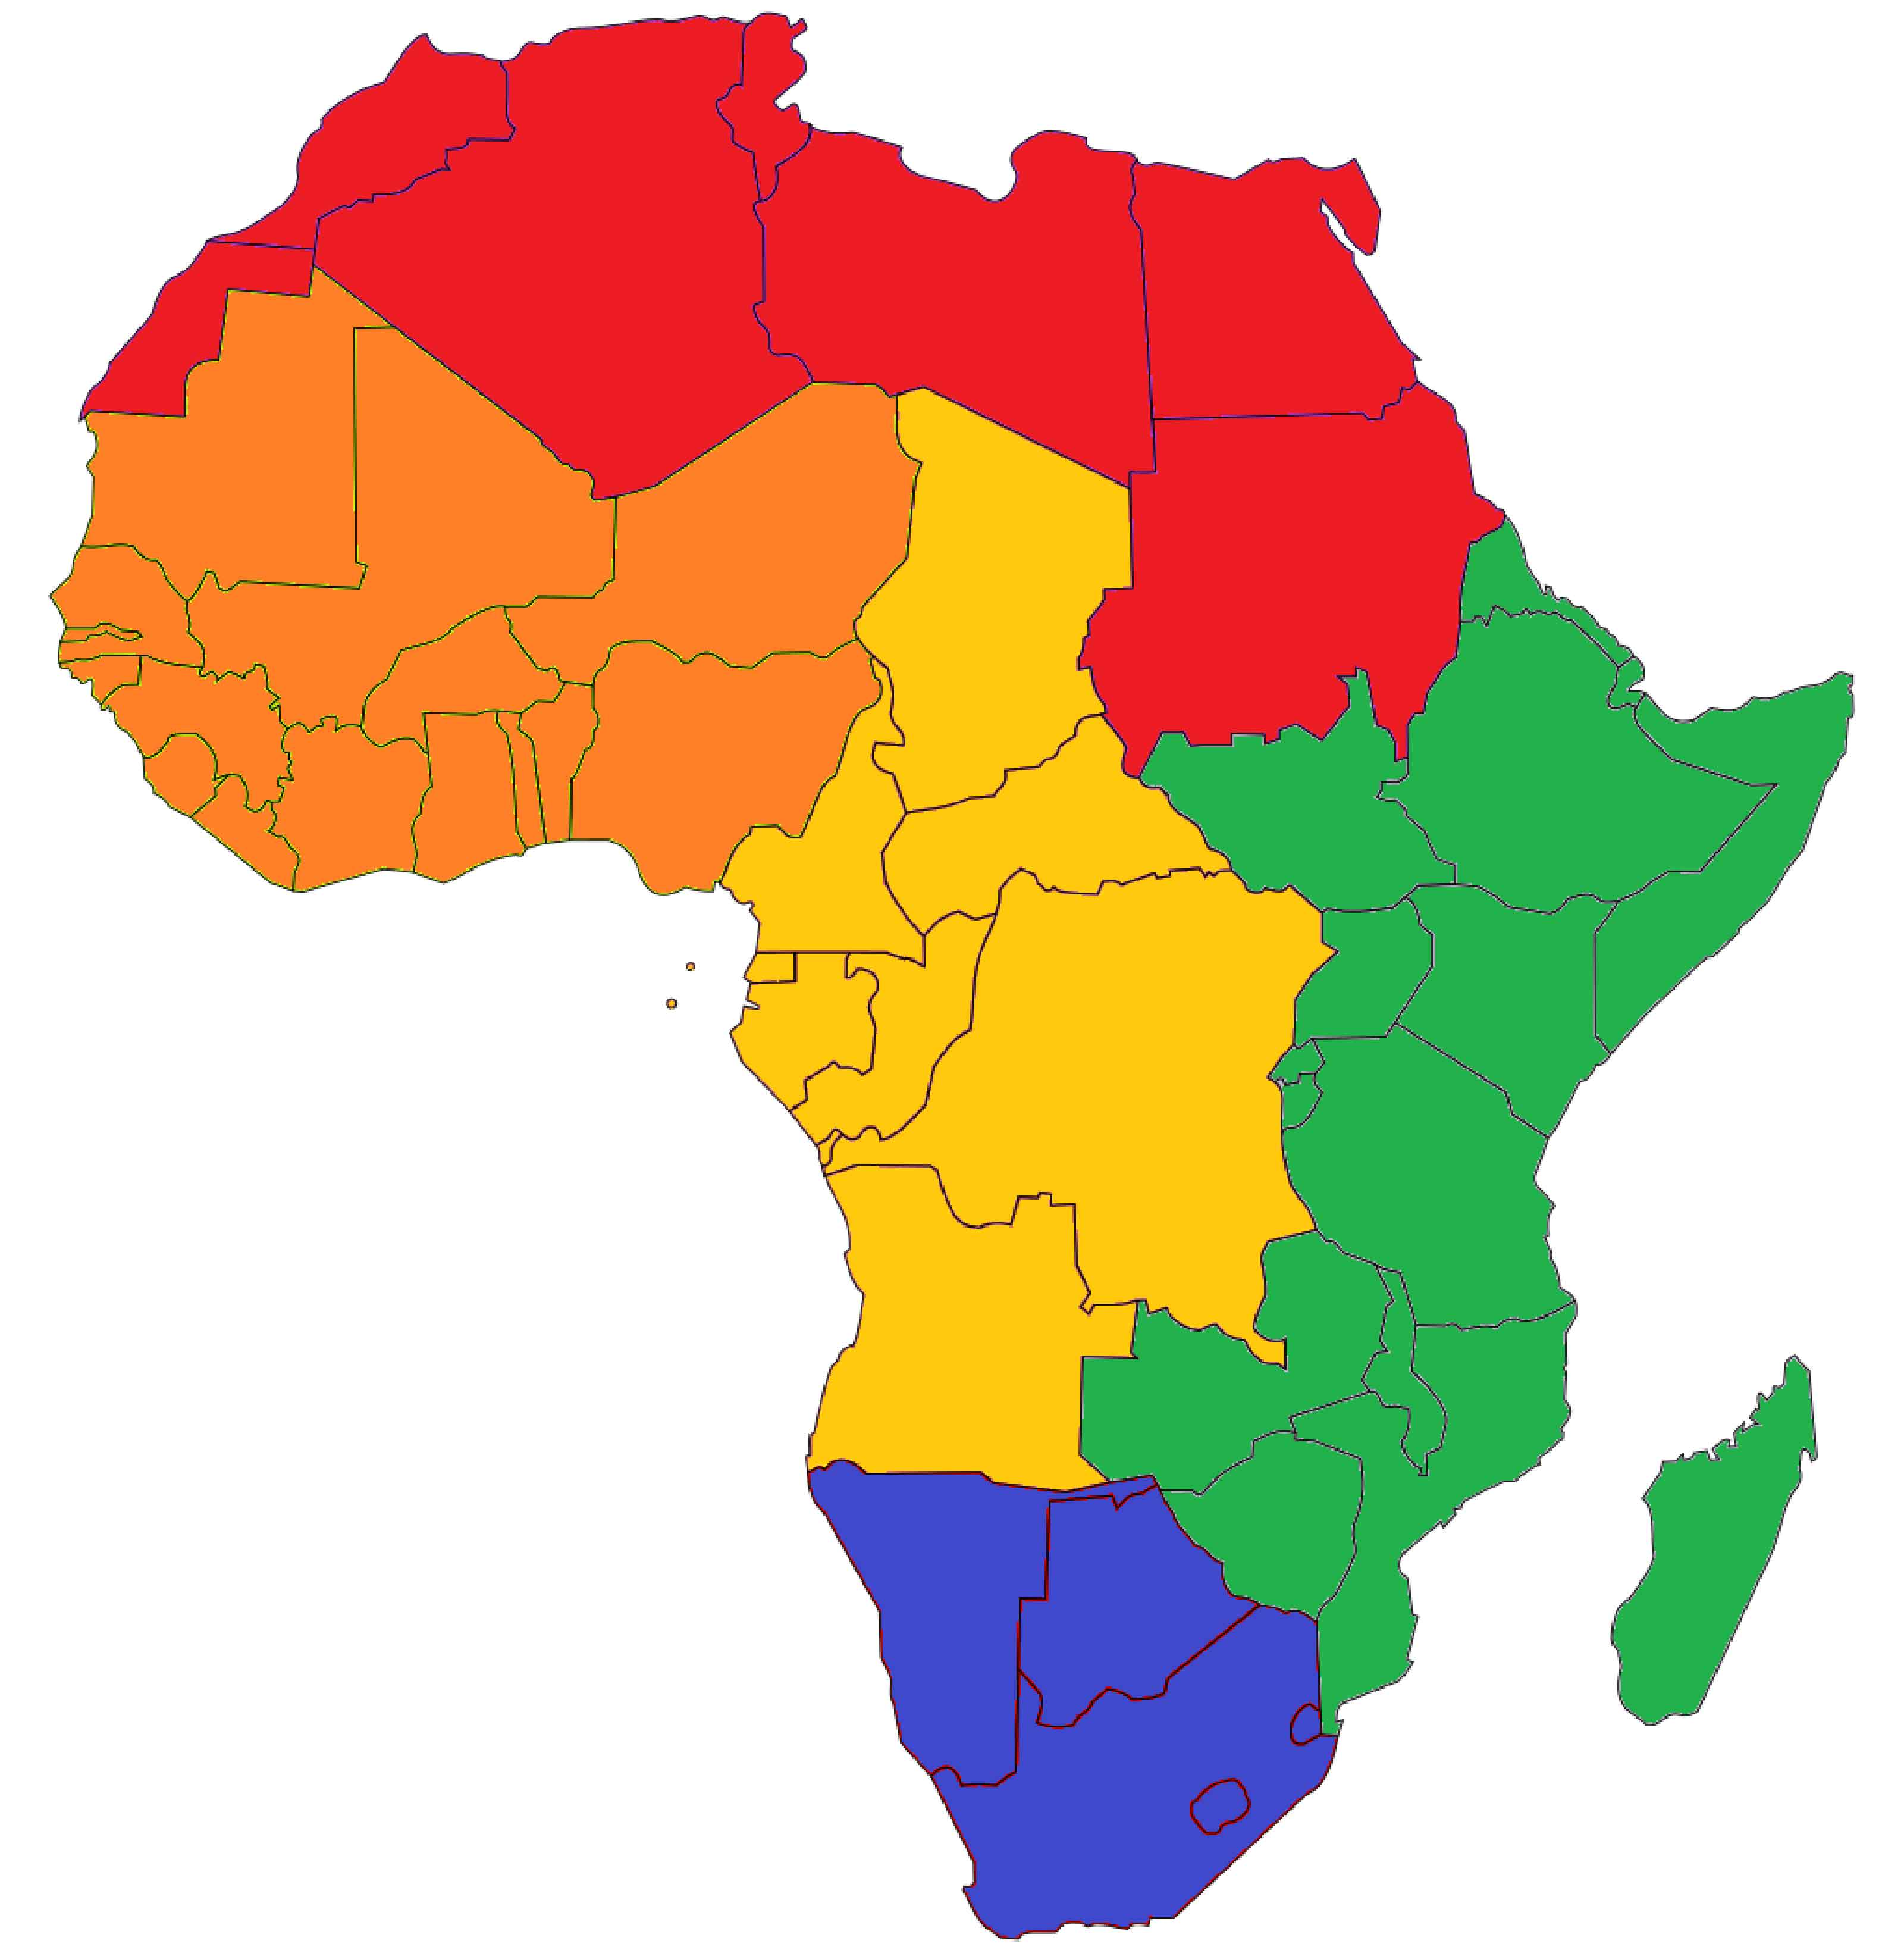
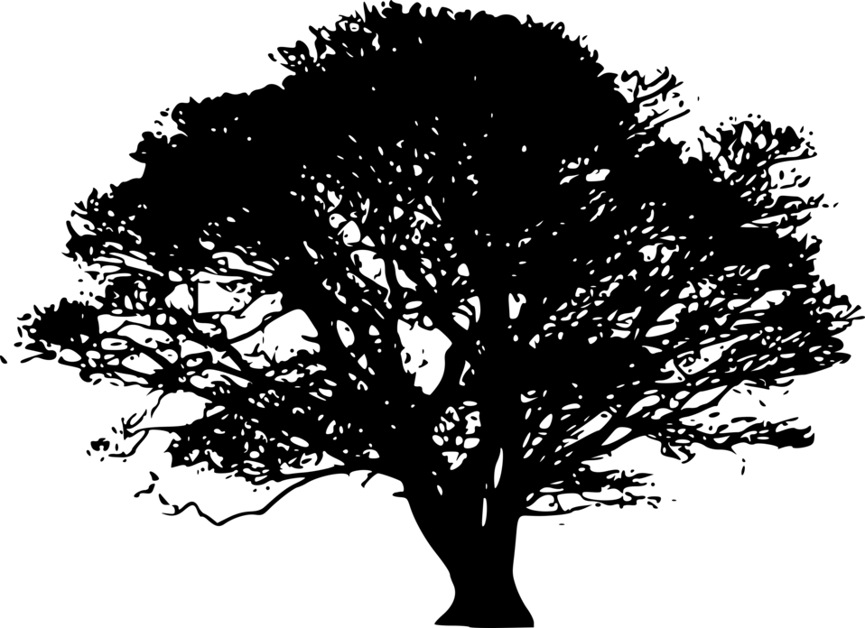
CONTINENT DIVISION
5 Subregions in AFRICA
Northern Africa
Western Africa
Central Africa
Eastern Africa
Southern Africa

Slide 4
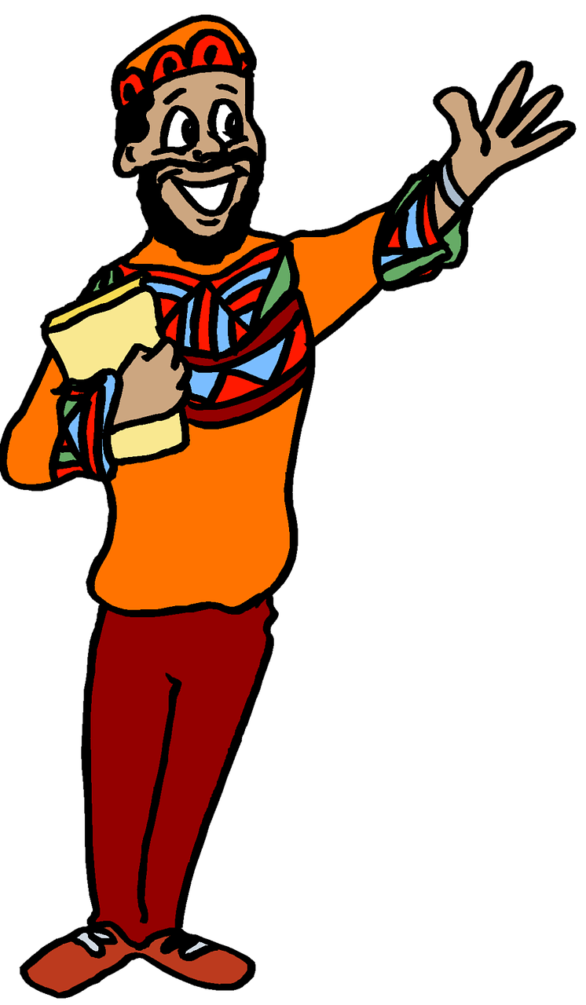
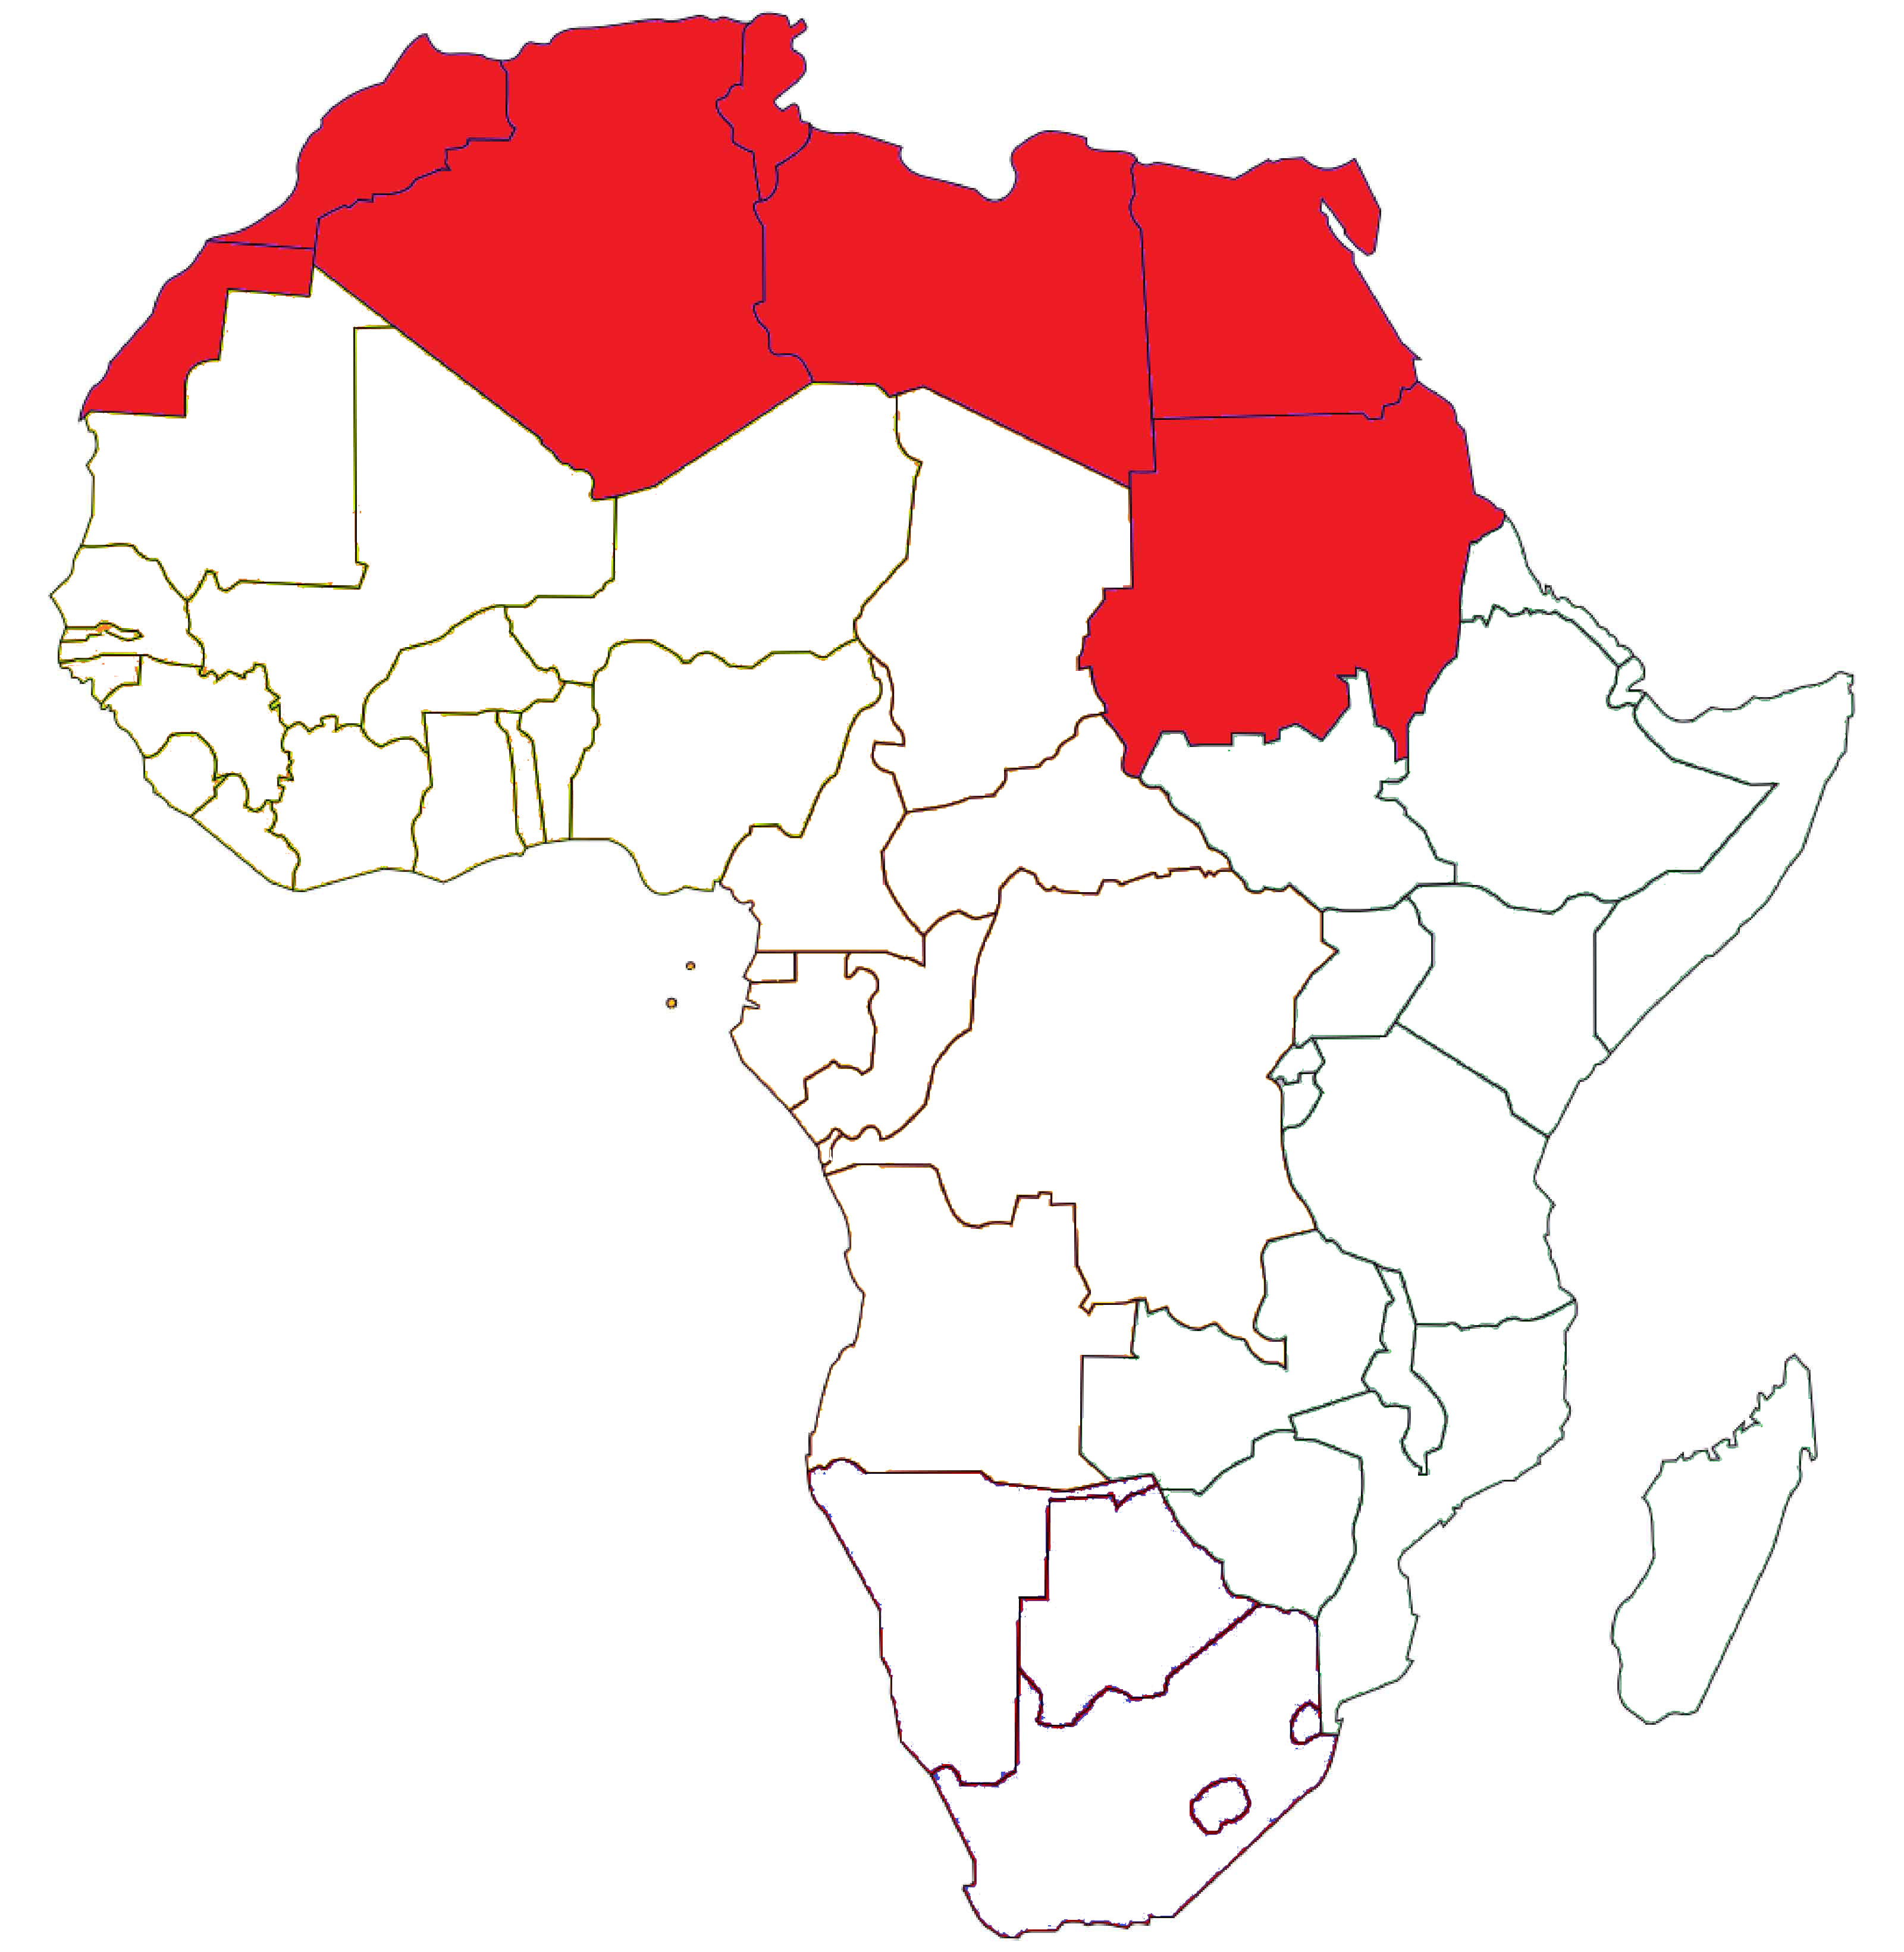
NORTHERN AFRICA
7 Countries in the North
Language: Arabic, French, Spanish and Berber are common used

Slide 5
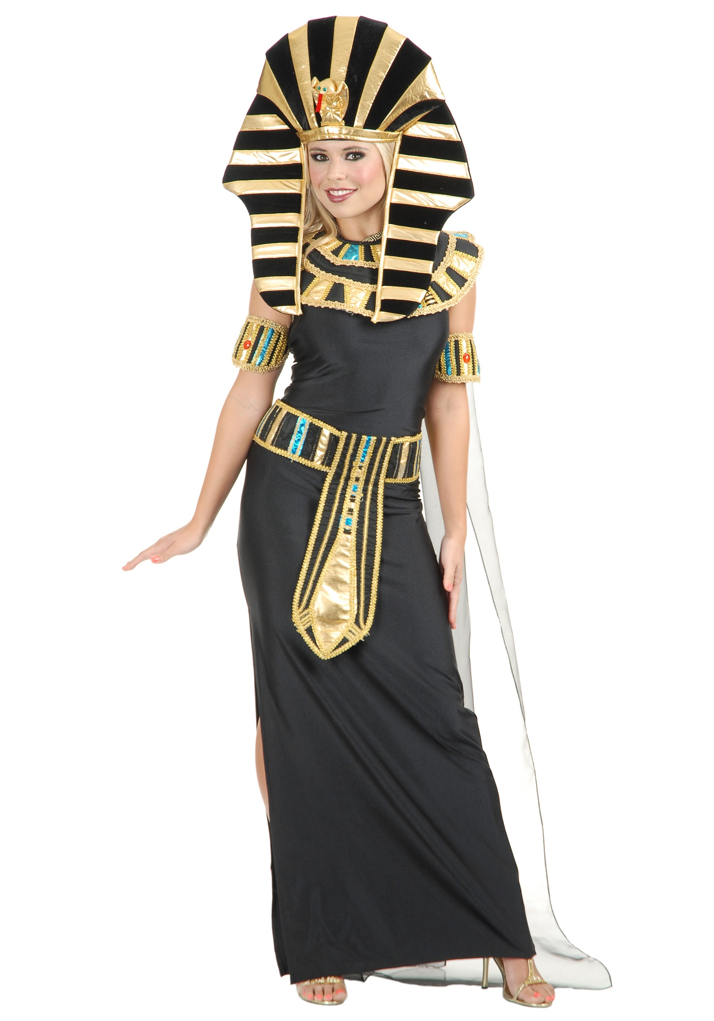
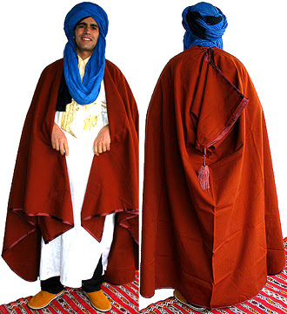
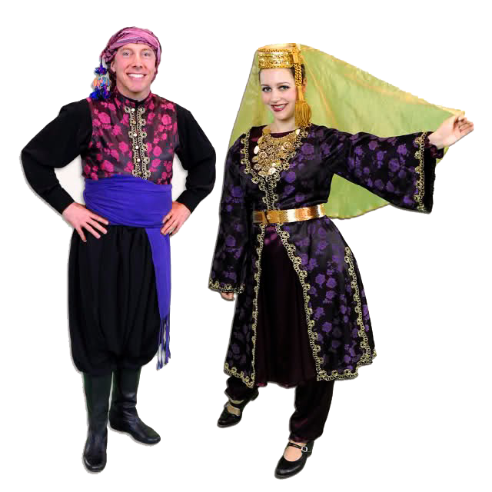
Clothes and design

Slide 6
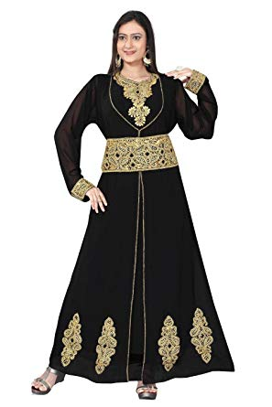
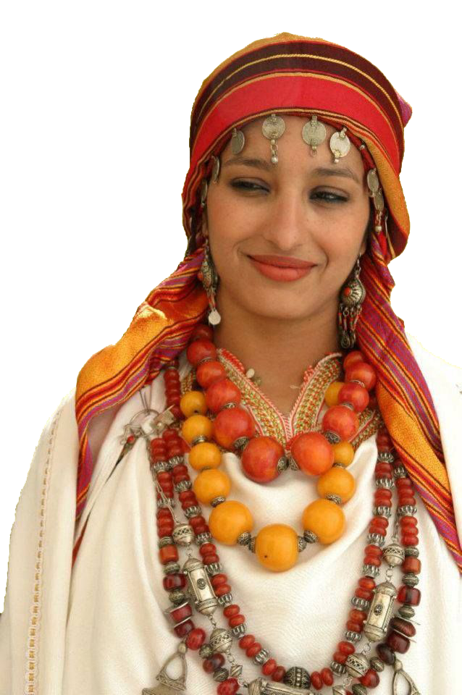
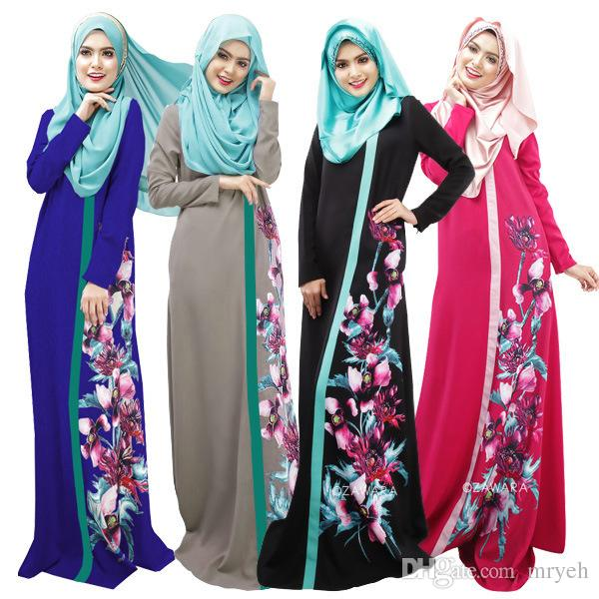
Clothe and design

Slide 7
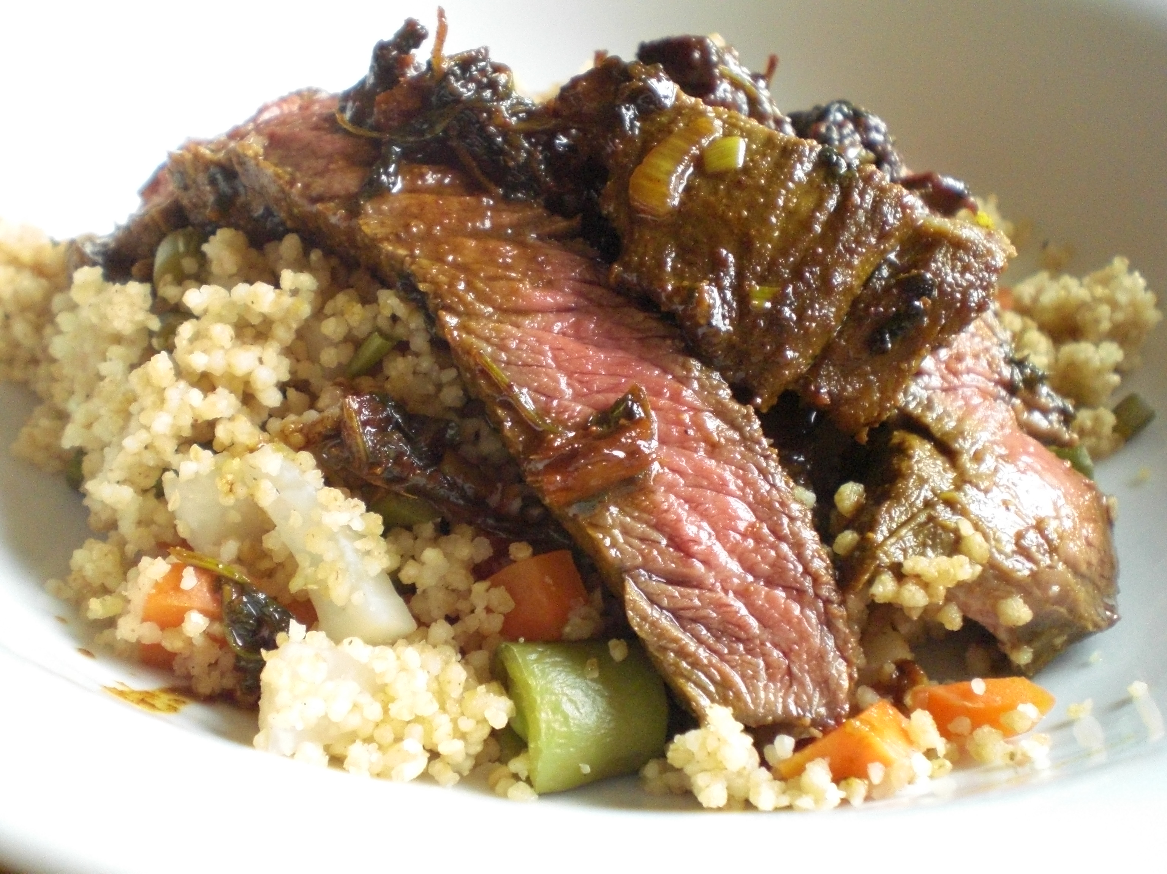
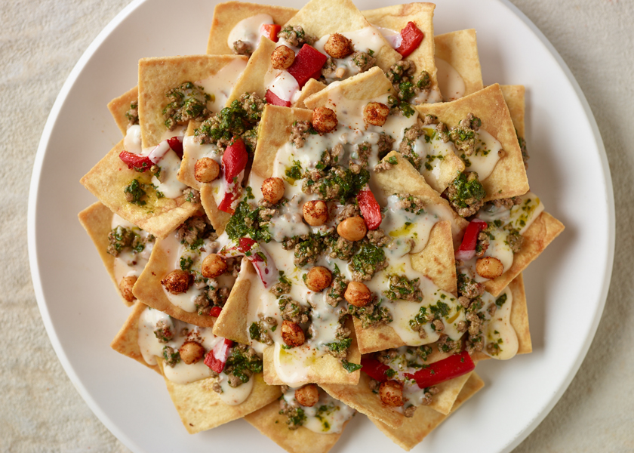
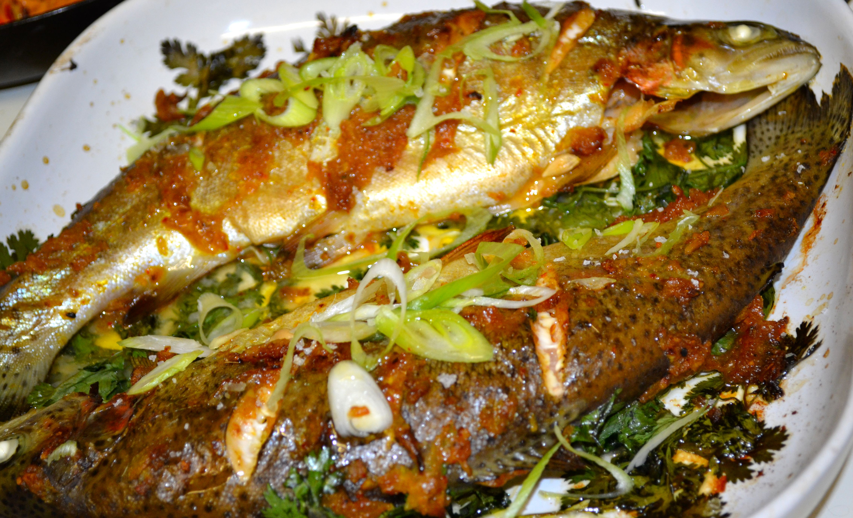
COMMON FOODS
Steak and Vegetable Couscous
Chermoula
Fished

Slide 8


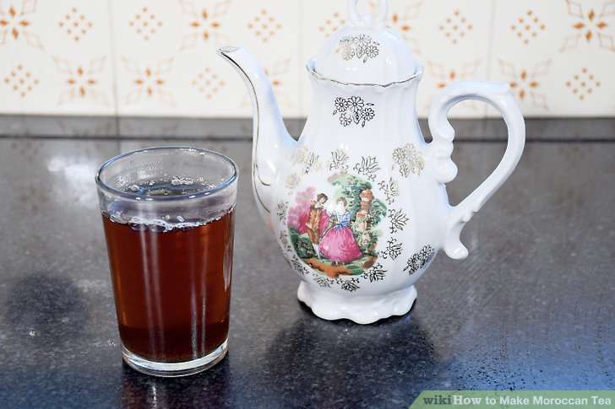
COMMON FOODS
Shakshouka – Moroccan Eggs Tagine
Moroccan dairy drink: Raibi
Tea

Slide 9
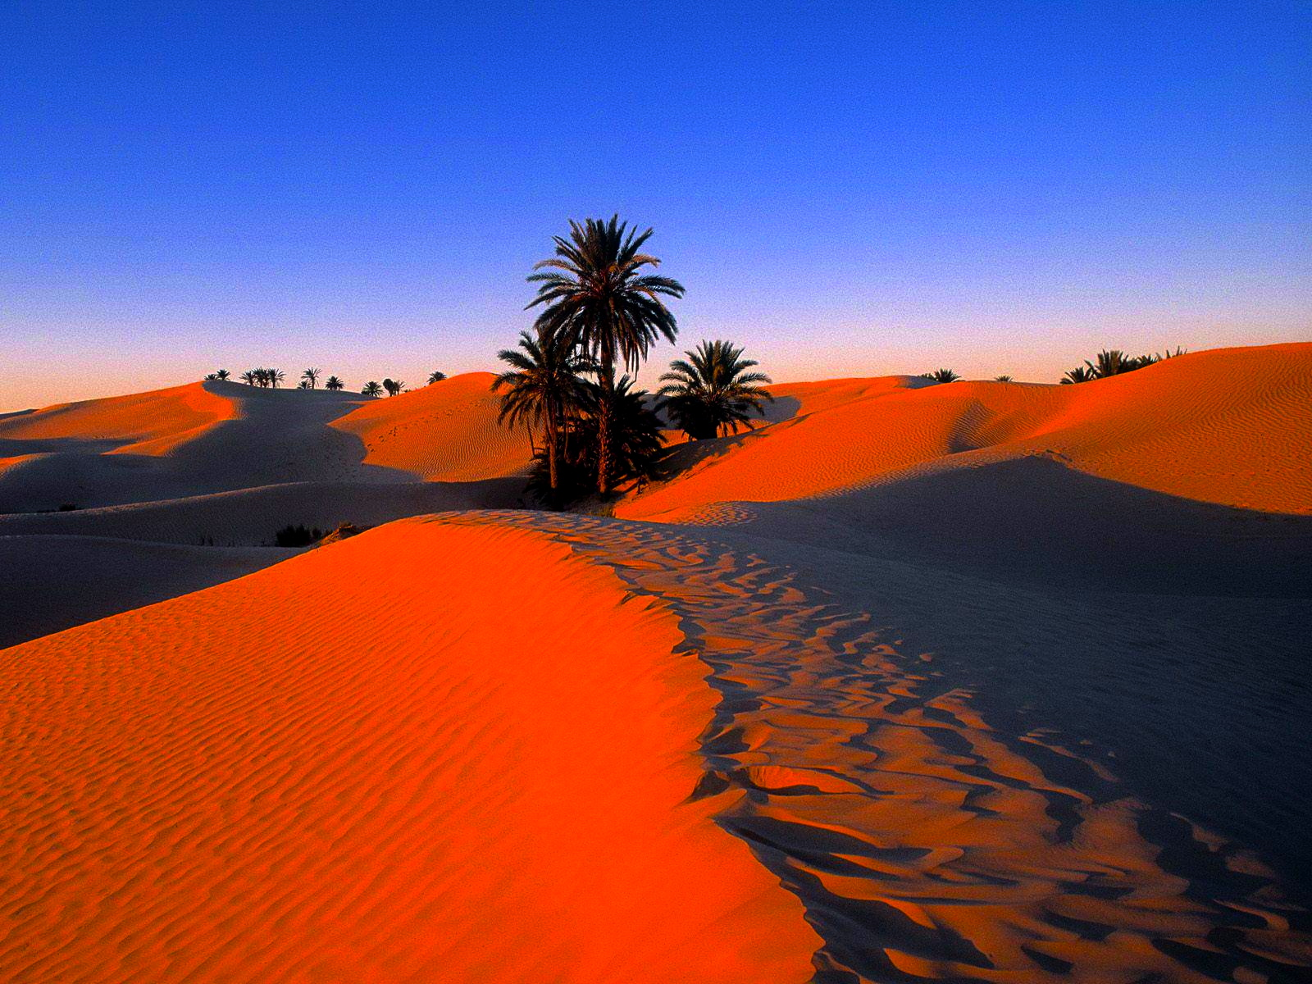
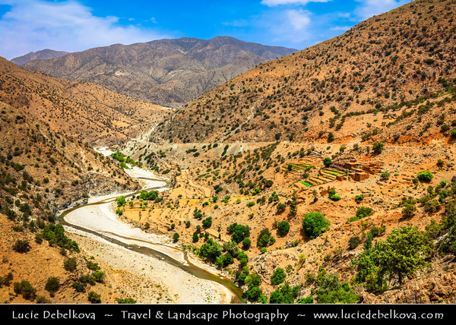
THE NATURE
Sahara Desert
Morocco - High Atlas Mountains

Slide 10
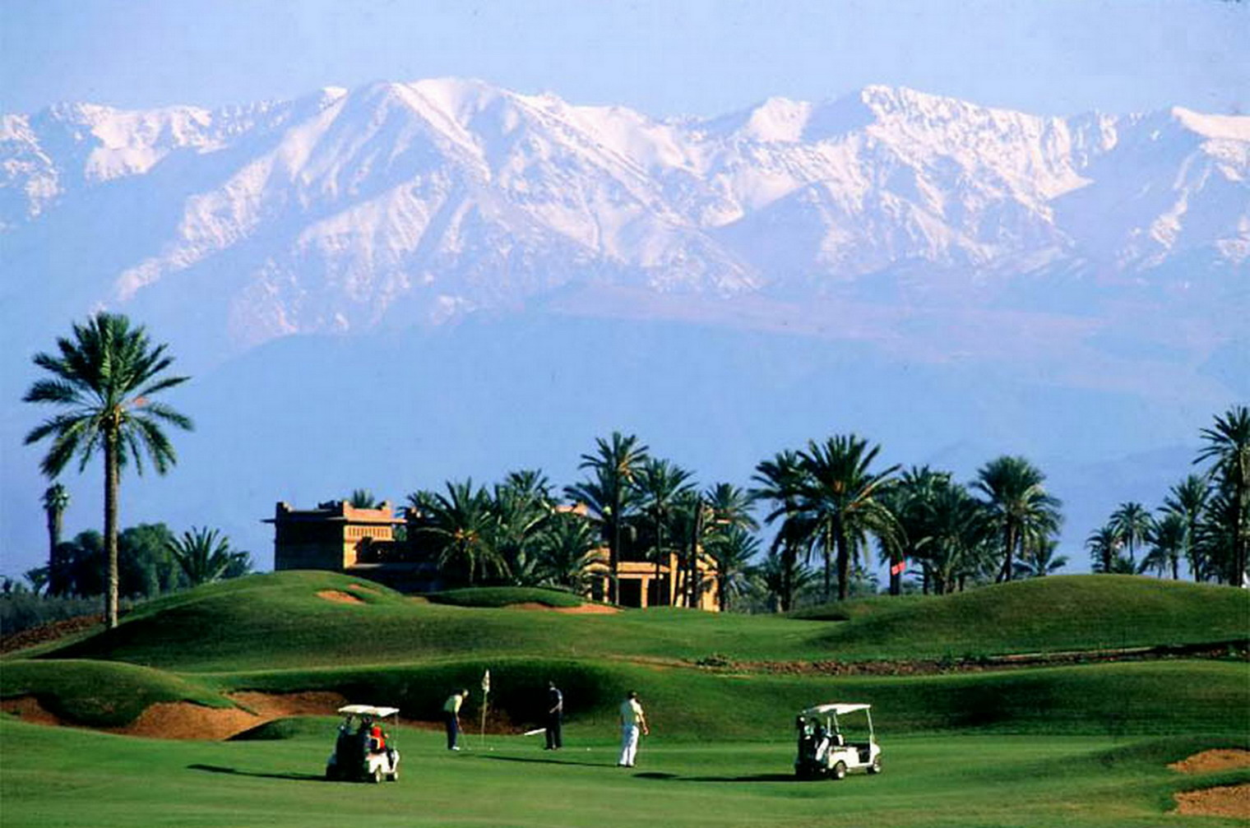
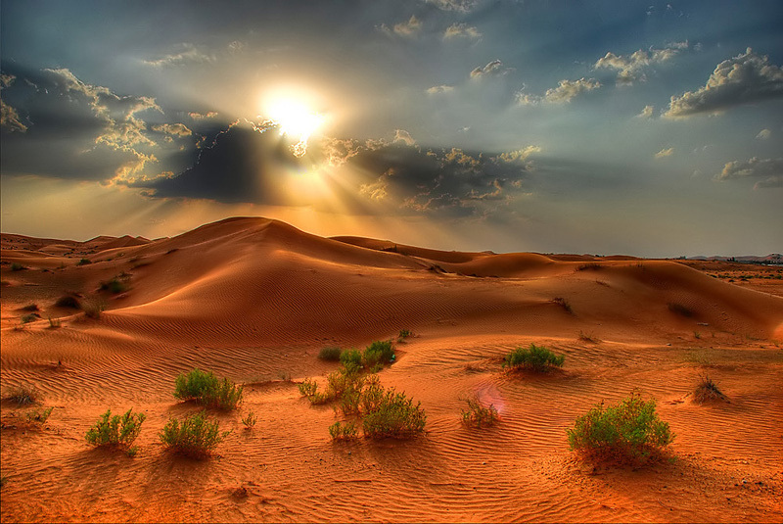
THE NATURE
Palmeraie Golf-Marrakech
Sahara

Slide 11
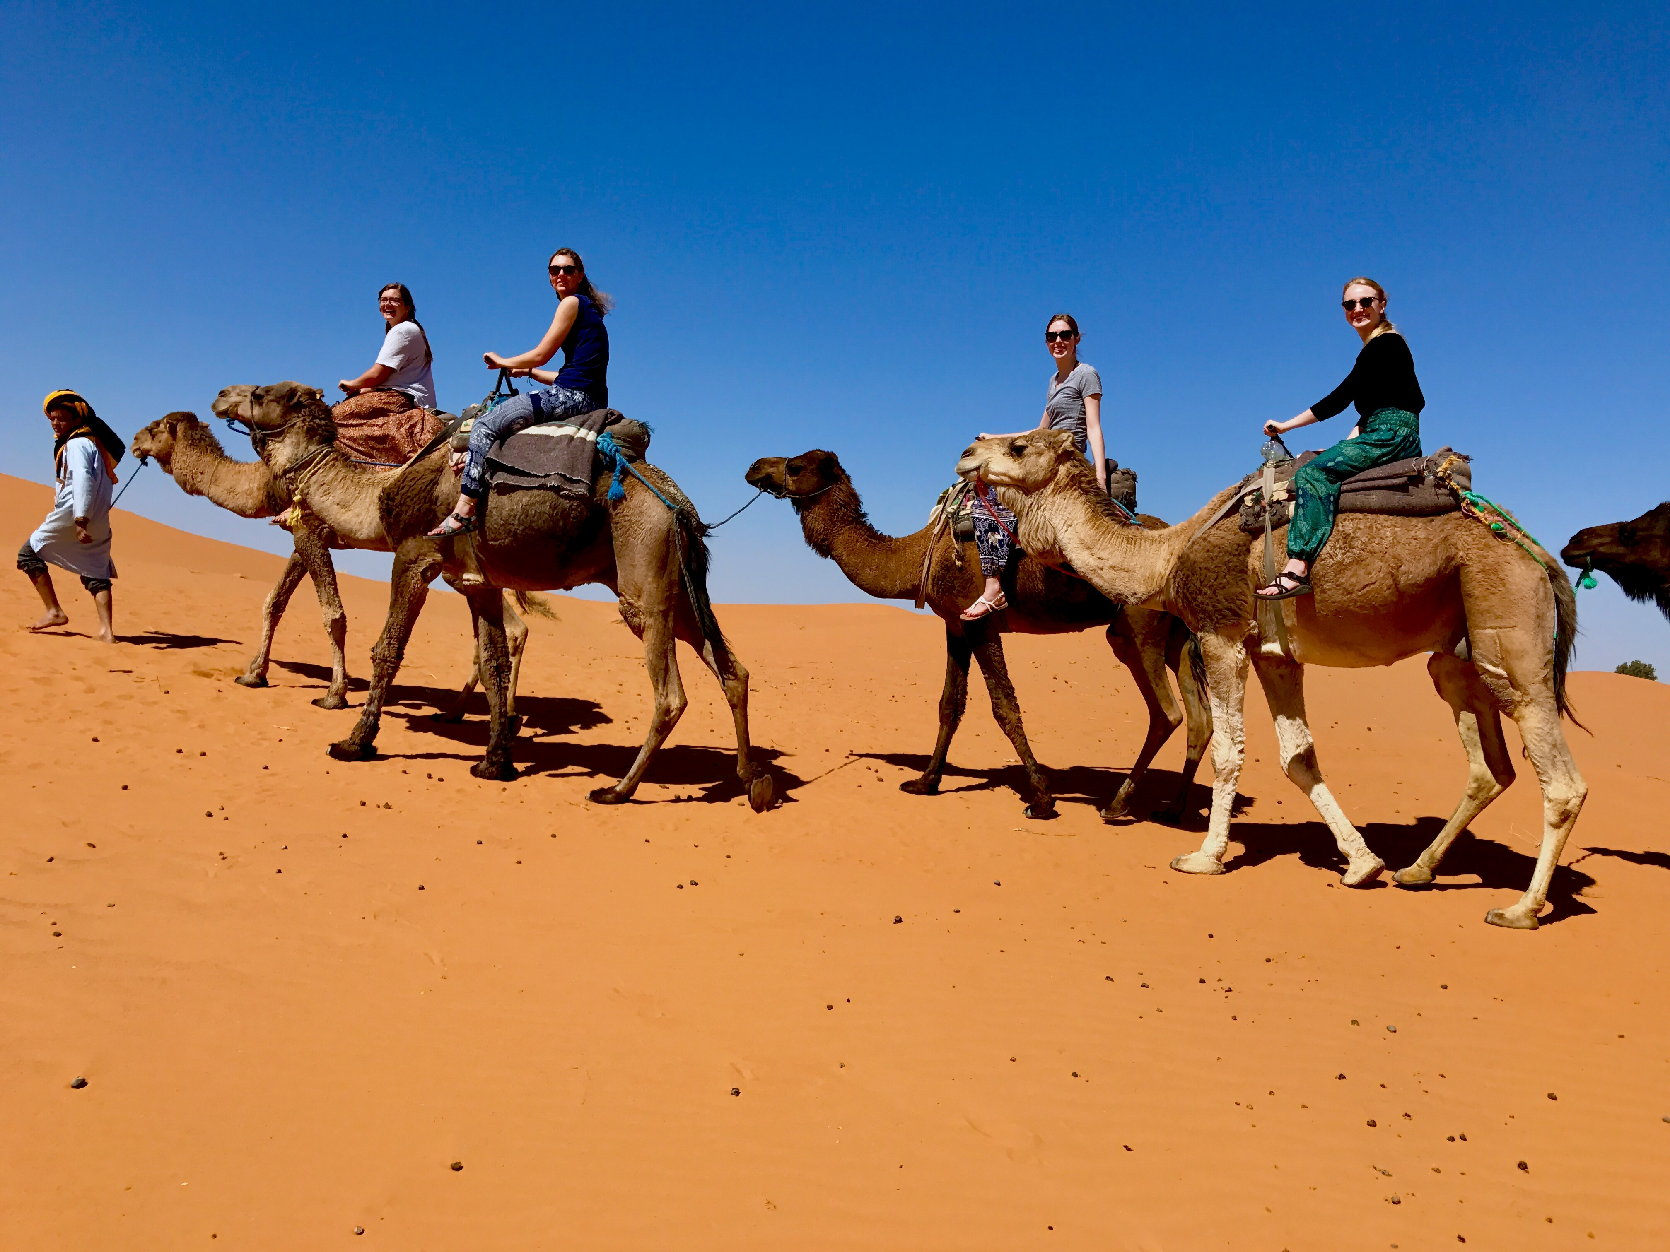
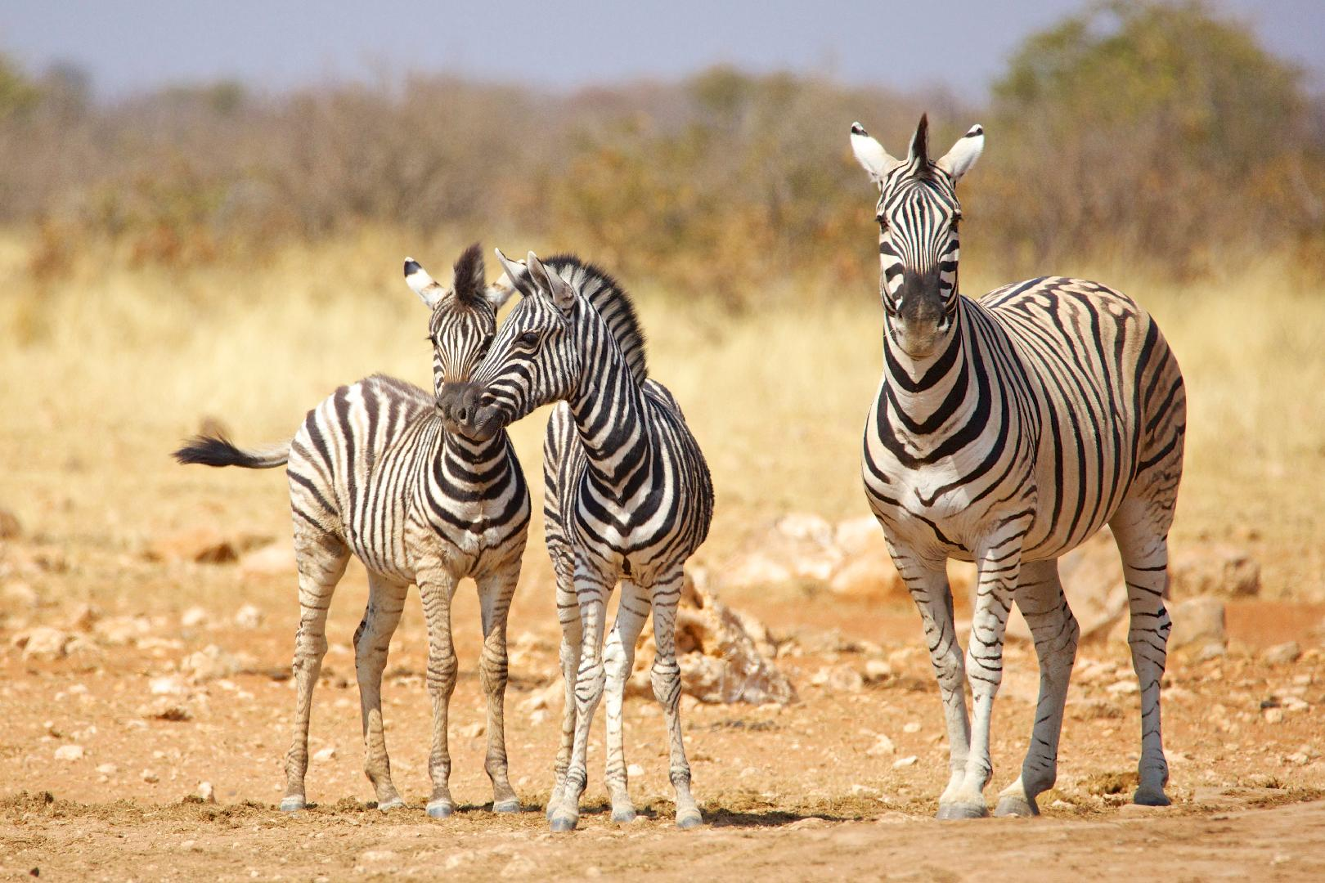
ANIMALS

Slide 12
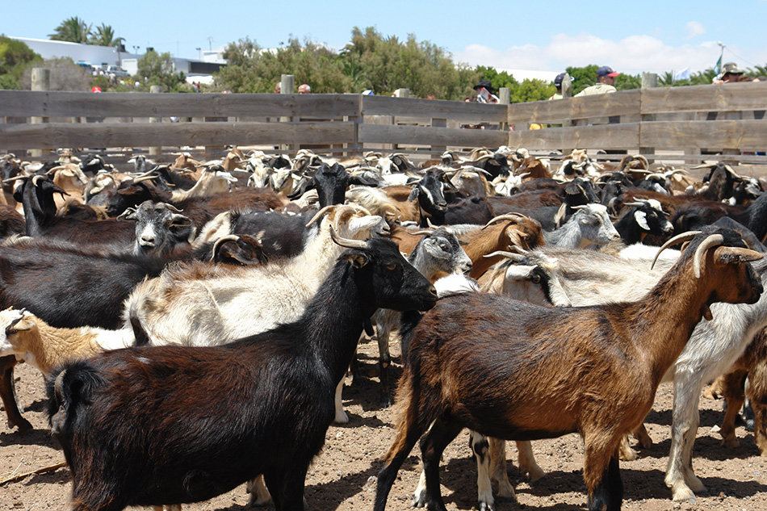
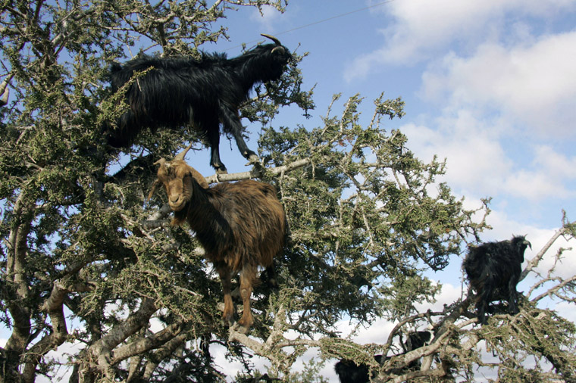
ANIMALS

Slide 13
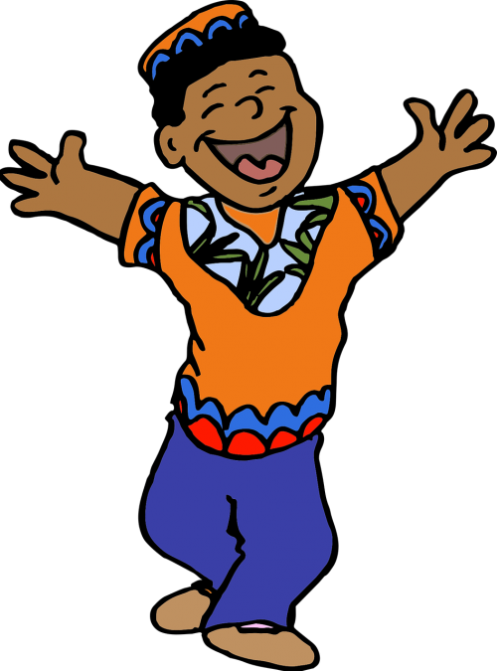
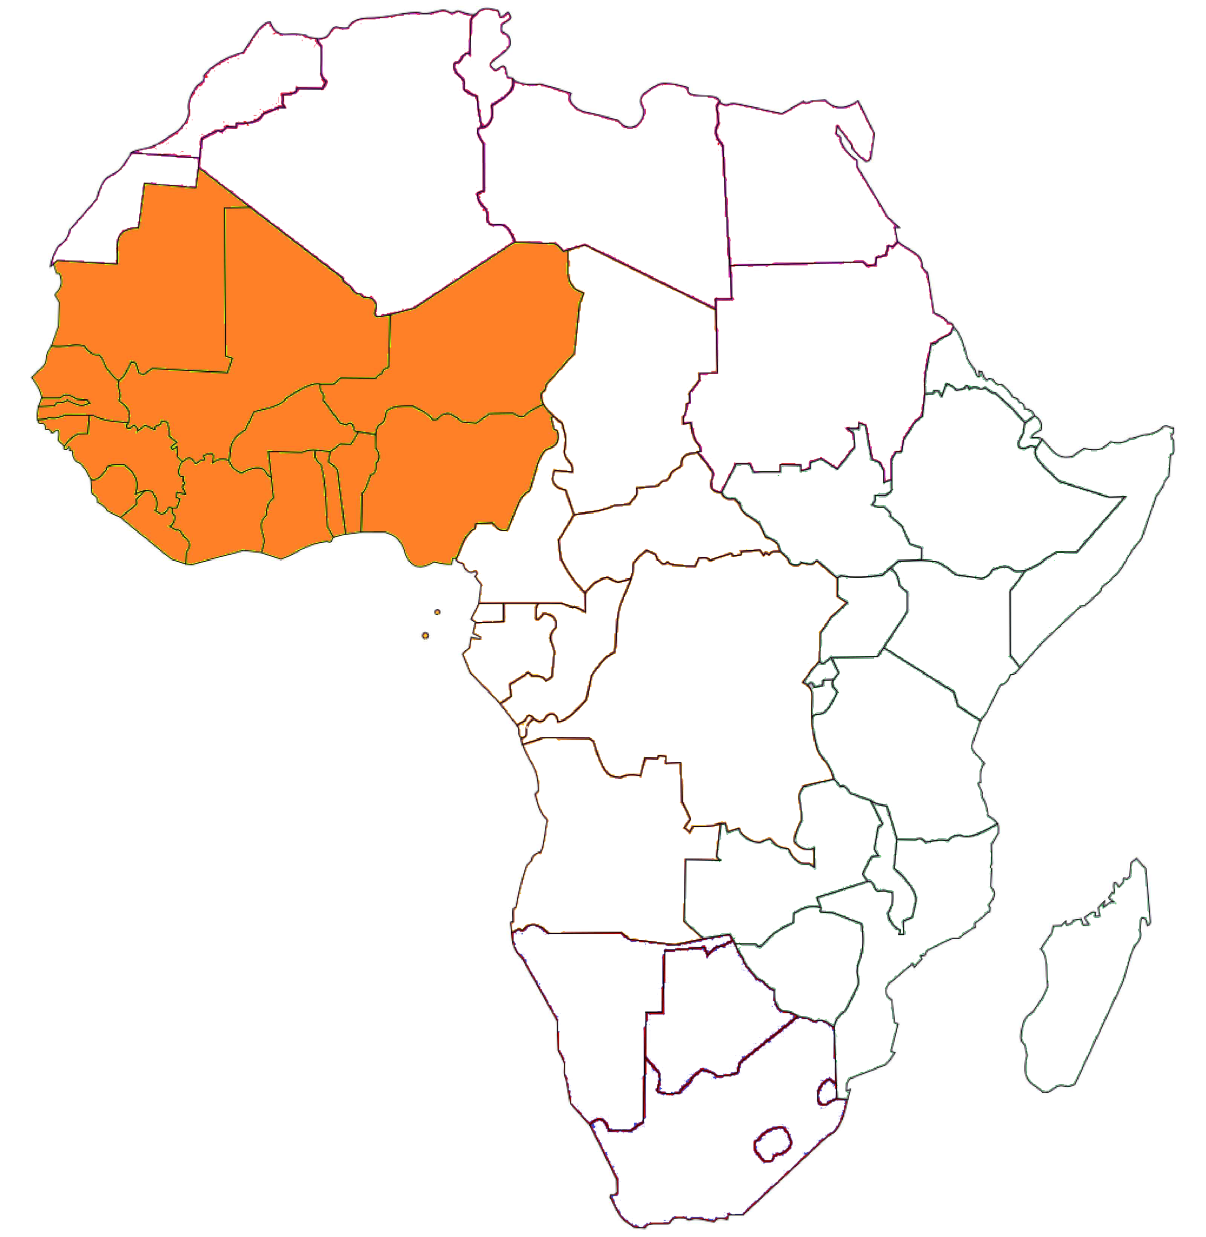
WESTERN AFRICA
17 Countries in Western Africa
Languages: French, English are most used

Slide 14
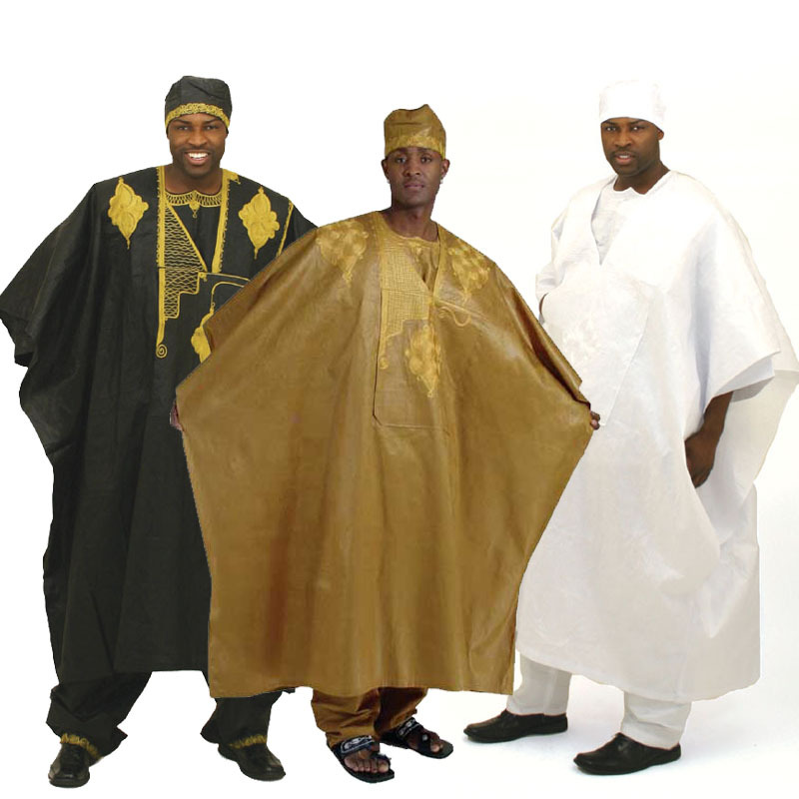

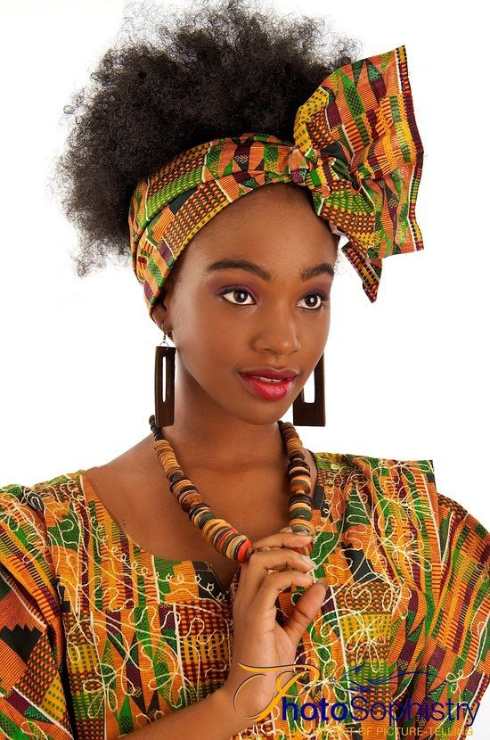
Fashion and design

Slide 15
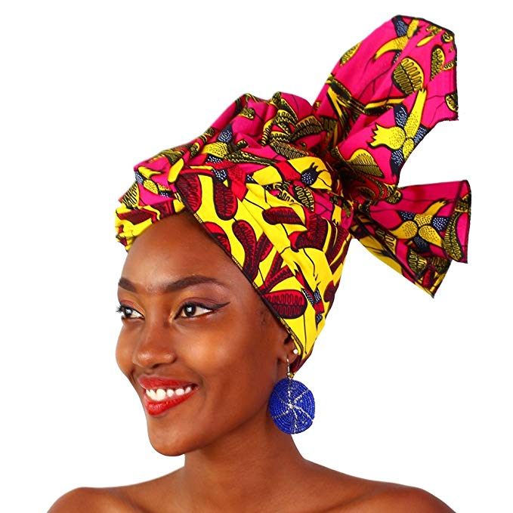


Fashion and style

Slide 16
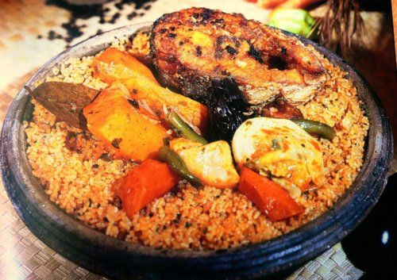
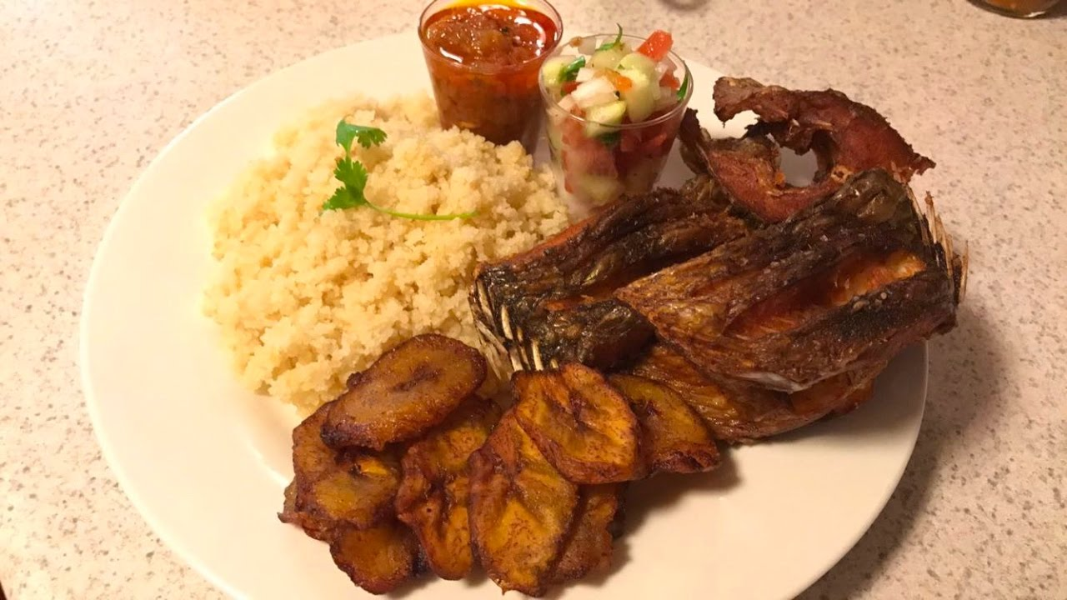
COMMON FOOD
Tchebou Djen
Atieke

Slide 17
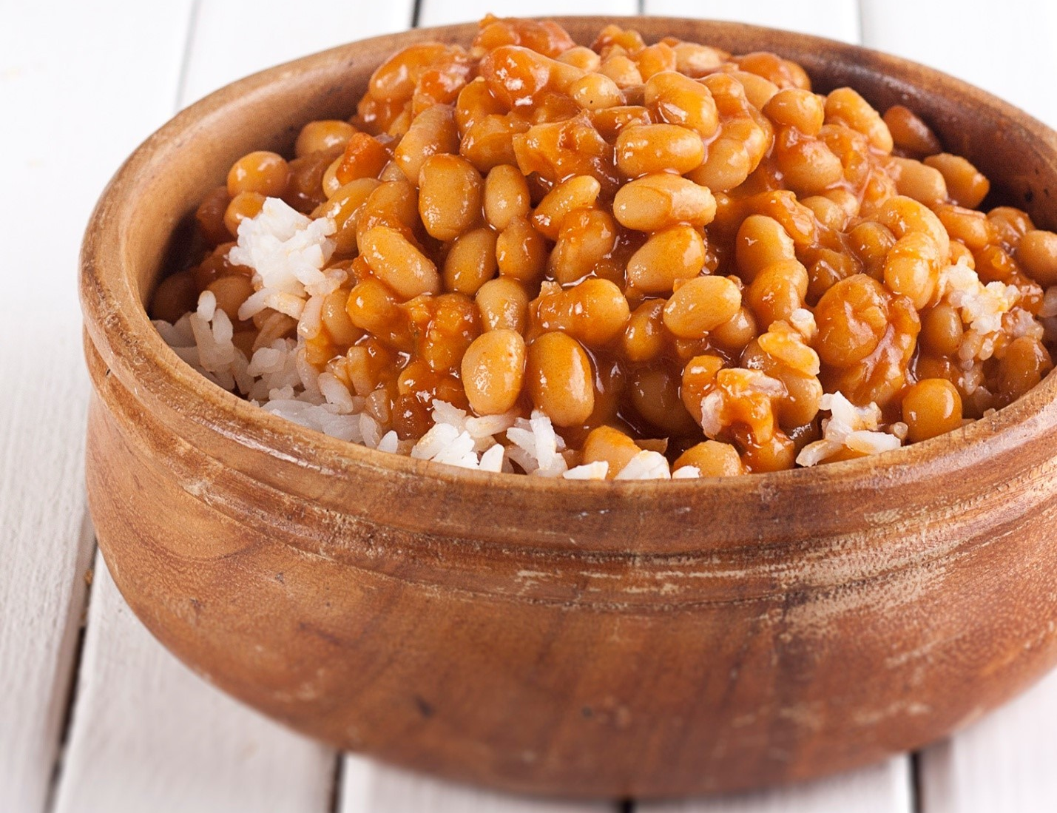
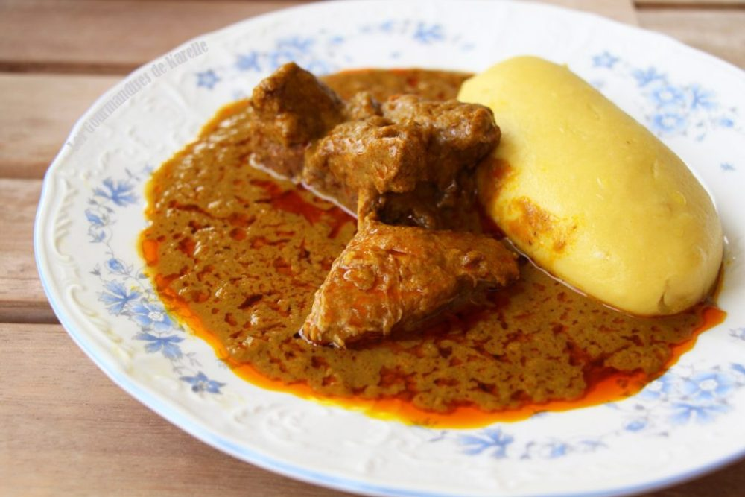
COMMON FOOD
Foutou
Beans

Slide 18
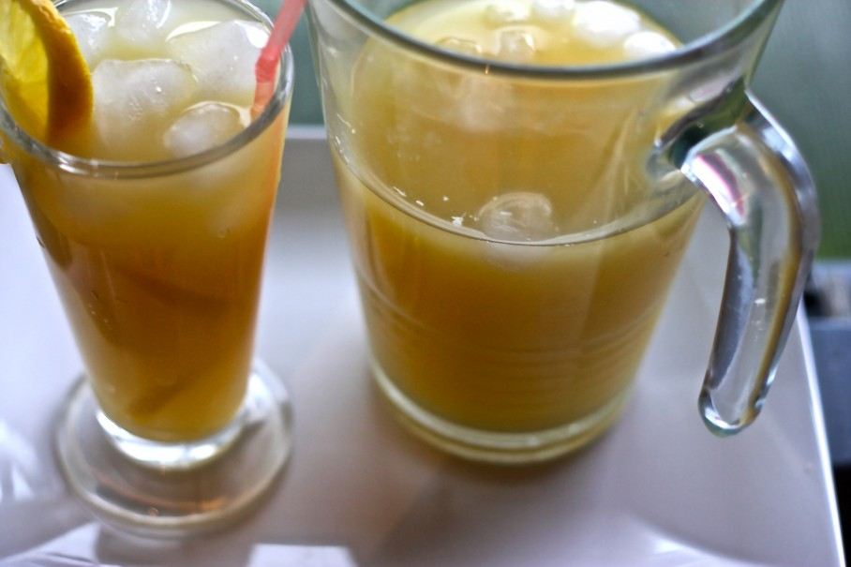

Common drinks
Ginger Jus
Mango Jus

Slide 19
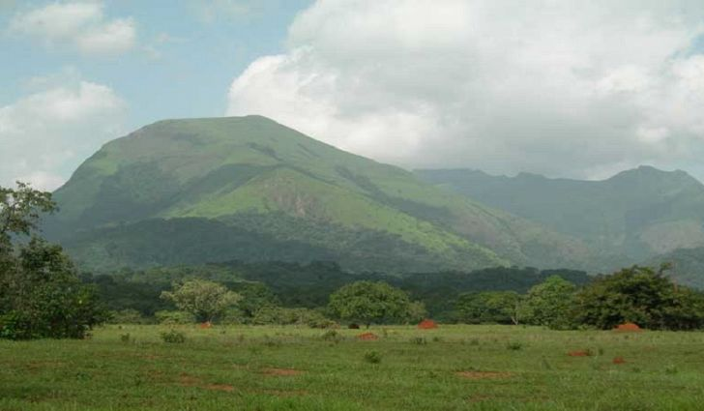
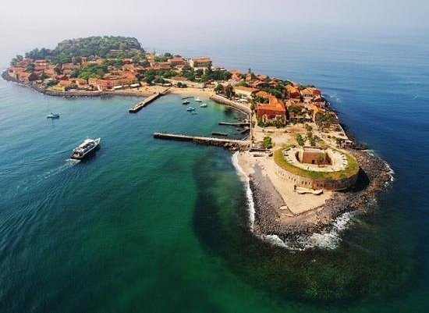
THE NATURE AND HISTORY
Mount Nimba
Goree Iland

Slide 20
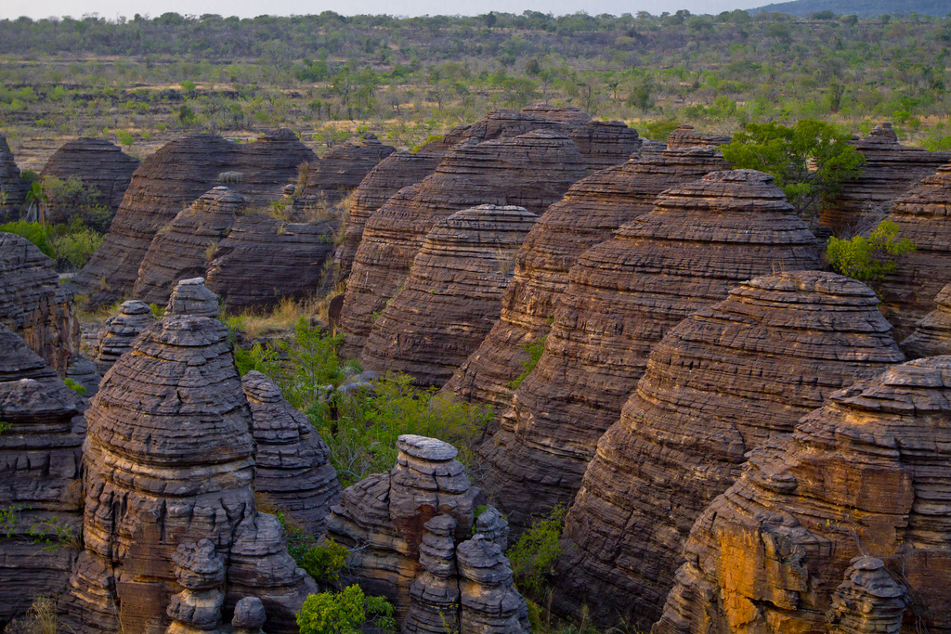
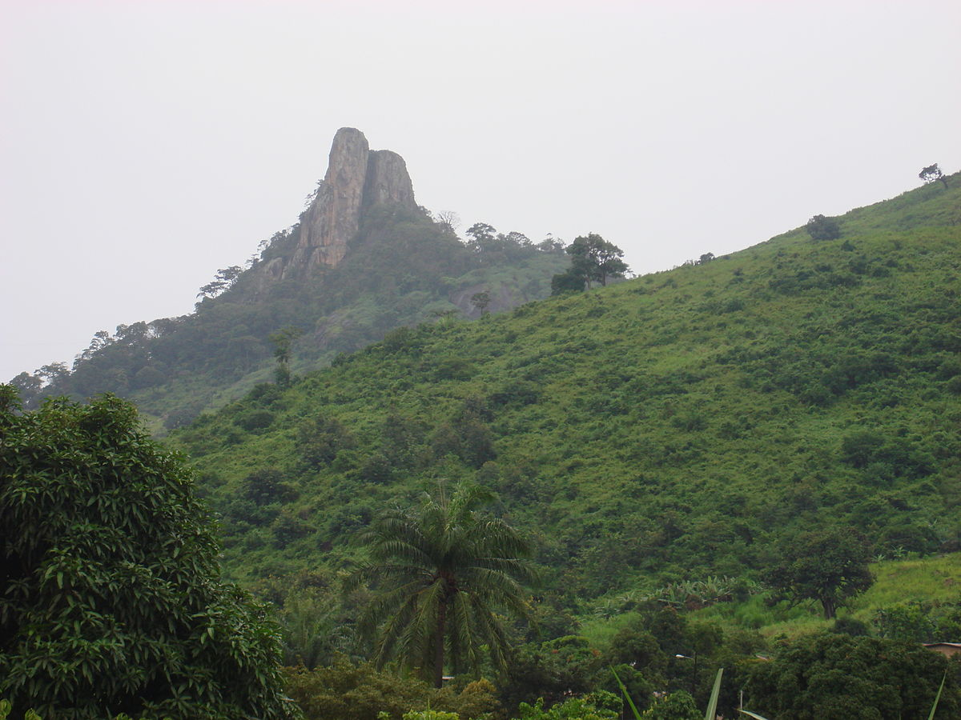
THE NATURE
Fabedougou
Tooth Of Man

Slide 21
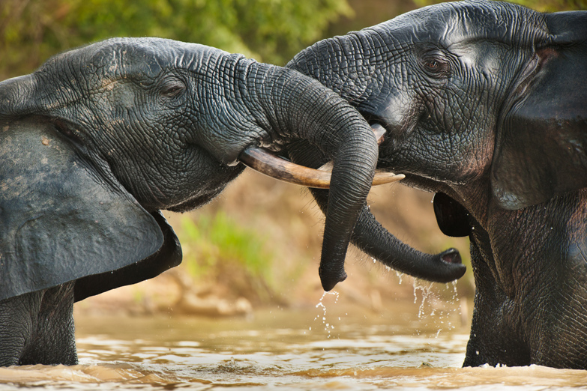
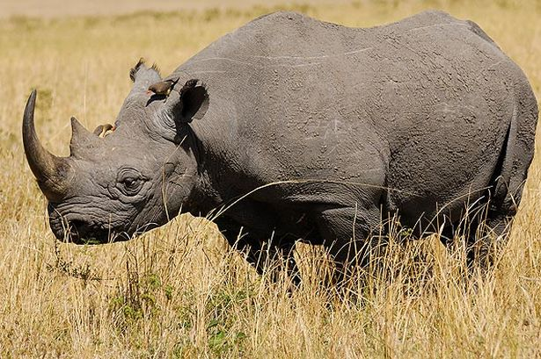
ANIMALS

Slide 22
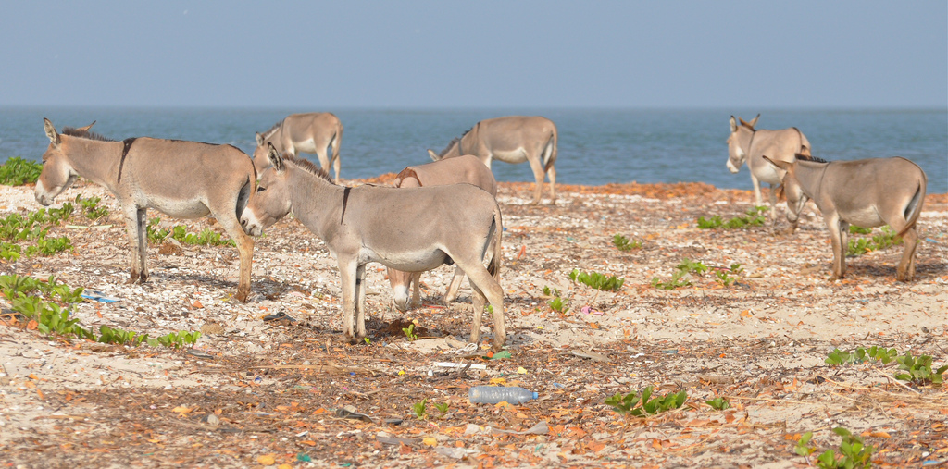
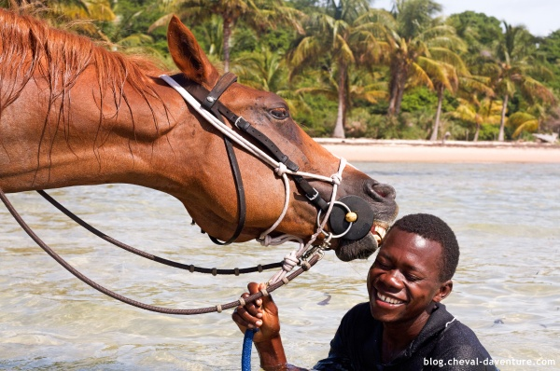
ANIMALS

Slide 23
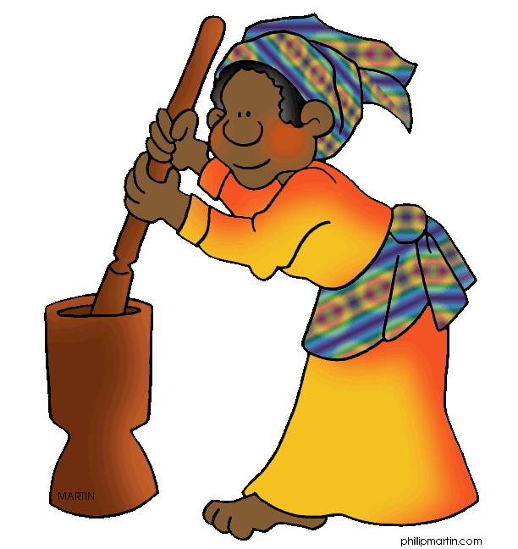
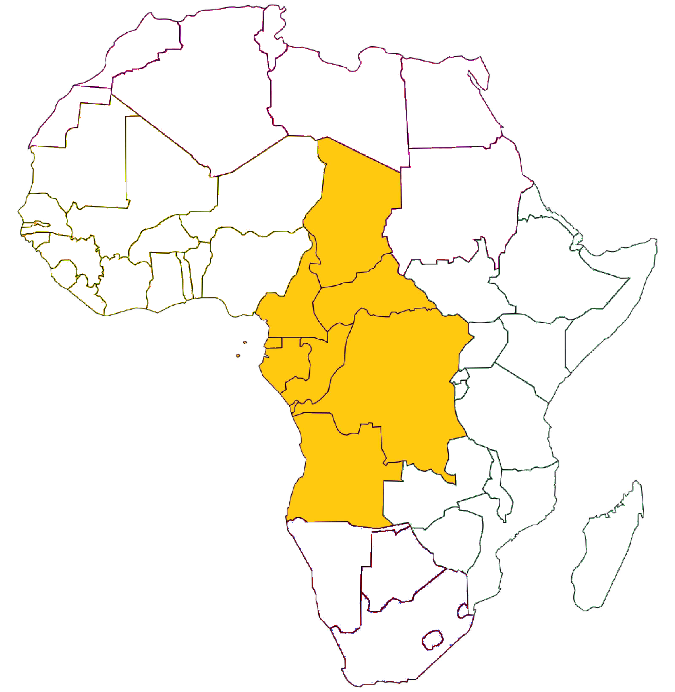
CENTRAL AFRICA
9 Countries in Central AFRICA
Language: English, French, Portuguese are most used

Slide 24
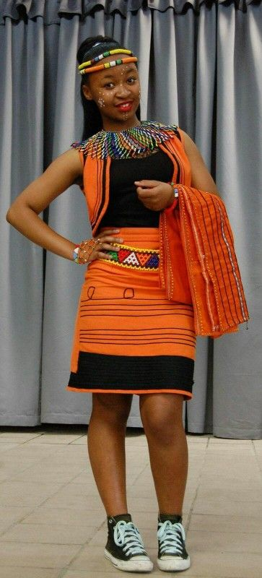
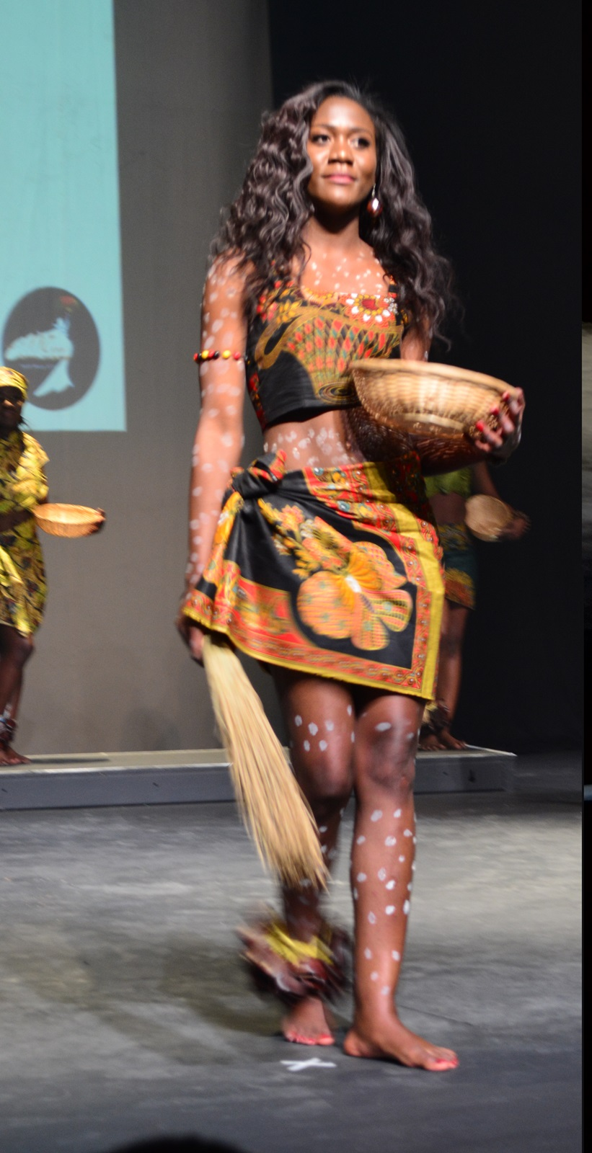

FASHION AND STYLE

